Slide 1
Music preference classification
A comparison of five classification models
750 labeled rows 13 features 200 target songs
Lab 1
Presenter: XINRAN LI
01
Notes:
任务：根据歌曲特征预测听众喜欢或不喜欢。数据和结果来自本作业的CSV及 results/results.json。

Slide 2
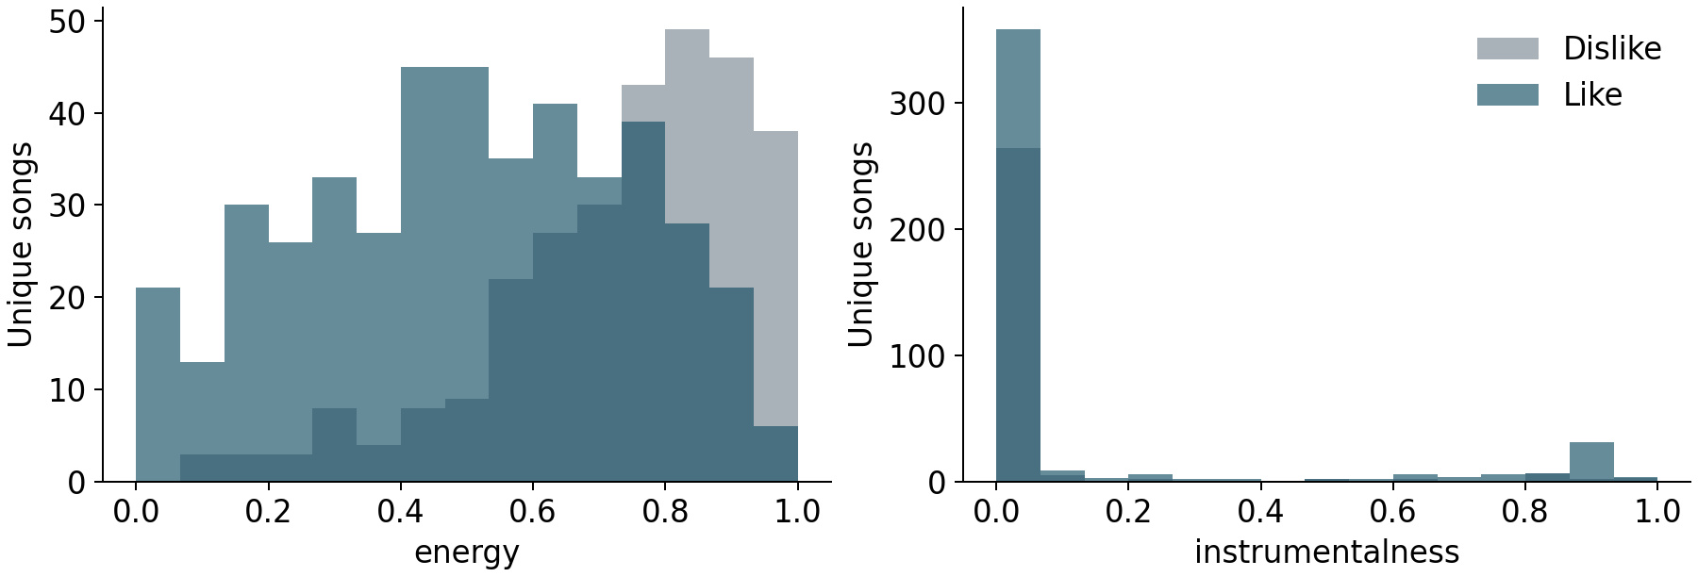
Dataset inspection
736 records after removing 14 duplicate feature rows
443 likes / 293 dislikes No missing or nonfinite values
The two classes overlap in energy and instrumentalness.
02
Notes:
14条冗余记录具有完全相同的输入特征，且标签一致。先去重再划分，避免完全重复记录跨训练和验证。没有歌曲ID，不能证明所有特征不同的记录一定来自不同歌曲。

Slide 3
Features and preprocessing
Inputs
Treatment and motivation
10 numeric features
StandardScaler for logistic regression, k-NN and SVM
Original scale for random forest and gradient boosting
One-hot encoding
Avoid imposing numeric distances on category codes
key, mode, time_signature
Feature selection / outliers
Keep all 13 inputs to limit additional model search
Retain plausible extreme values
Numeric: acousticness, danceability, duration, energy, instrumentalness,
liveness, loudness, speechiness, tempo and valence
03
Notes:
所有13个特征保留。类别编码不具有普通数值距离含义。标准化只对逻辑回归、kNN和SVM使用。训练数据没有缺失值，当前代码没有中位数填补。duration以毫秒为单位。极端值缺少错误证据，因此保留。

Slide 4
Validation and model selection
Fixed split
588 development records and 148 holdout records
Stratified sampling with random seed 42
Shared five-fold cross-validation
Use the same development folds for every model and setting
Fit preprocessing within each fold’s training portion
Selection rule
Choose the highest mean CV accuracy
Freeze the choice before evaluating the holdout
04
Notes:
736条记录分层划分为588开发集和148留出集。所有模型共享五折。标准化和类别编码在每折训练部分学习。根据开发集CV平均准确率选择，不用留出集反复调参。seed=42保证复现，没有特殊统计含义。

Slide 5
Logistic regression and k-NN
Logistic regression
A weighted feature score becomes a probability through sigmoid
A linear boundary in the encoded feature space
C controls regularization strength
k-nearest neighbors
Nearby training records vote with equal or distance-based weights
Sensitive to feature scales, irrelevant inputs and neighbor count k
Both methods standardize numeric inputs and encode categories.
05
Notes:
逻辑回归把加权特征映射到喜欢概率。kNN寻找特征接近的训练记录，用标签投票。距离加权让较近邻居权重更大。两者标准化数值列，并对类别列独热编码。官方文档：https://scikit-learn.org/stable/supervised_learning.html

Slide 6
Support vector machine with RBF kernel
Classification boundary
Seek a large margin between classes
Support vectors determine the boundary
RBF kernel
Capture nonlinear relationships between song features
Standardize numeric inputs and encode categories
Tuning
C controls the penalty for margin violations
gamma controls how local the kernel similarity is
06
Notes:
SVM寻找间隔较大的分类边界，支持向量决定边界。RBF核可实现非线性边界。C越大，对错误或间隔违反的惩罚通常越强。gamma越大，相似度影响越局部，可能更容易过拟合。官方文档：https://scikit-learn.org/stable/modules/svm.html

Slide 7
Random forest and gradient boosting
Random forest
Train trees on bootstrap samples with random candidate features
Combine their predicted class probabilities
Depth and minimum leaf size limit complexity
Gradient boosting
Add shallow trees sequentially to reduce prediction loss
Learning rate, tree count and depth work together
Both methods encode categories and retain numeric feature scales.
07
Notes:
随机森林在bootstrap样本上训练不同树，每次分裂随机选择候选特征，最后综合概率。梯度提升依次添加树以减少损失。两种方法均编码类别，但不需要标准化数值。官方文档：https://scikit-learn.org/stable/modules/ensemble.html

Slide 8
Hyperparameter search
Model
Search space
Settings
Logistic regression
C: 0.01, 0.1, 1, 10
4
k-NN
k: 3, 5, 9, 15, 25, 41
Weights: uniform / distance
12
RBF SVM
C: 0.1, 1, 10, 100
gamma: scale, 0.01, 0.1
12
Random forest
150 trees. Depth: 4, 8, unrestricted
Minimum leaf size: 1, 3, 8
9
Gradient boosting
Trees: 100 / 200. Rate: 0.03 / 0.1
Depth: 1 / 2
8
45 settings × 5 folds = 225 validation fits. Tuning metric: accuracy.
08
Notes:
45组参数乘5折得到225次验证训练，不包含GridSearchCV最后的全开发集重新拟合。模型名后的参数均为实际尝试的范围。官方文档：https://scikit-learn.org/stable/modules/grid_search.html

Slide 9
Cross-validation comparison
Mean five-fold accuracy
Fold SD (pp)
Random forest
83.33%
3.63
Gradient boosting
83.00%
3.81
RBF SVM
82.32%
2.67
Logistic regression
81.62%
4.50
k-NN
81.29%
1.95
0%
100%
Majority baseline: 60.20%. CV scores include tuning optimism.
Random forest leads gradient boosting by only 0.33 percentage points.
09
Notes:
横条长度读取results/results.json中五折平均准确率，共同尺度0–100%。柱形和文字可分别编辑，不依赖原生图表插件。右列Fold SD为折间标准差，单位百分点，不是置信区间。随机森林83.33%，梯度提升83.00%，差约0.33个百分点，不能证明有显著优势。调参分数可能乐观。

Slide 10
Selected model: holdout evaluation
Random forest: 120/148 correct = 81.08%
Majority baseline: 60.14%
Actual / predicted
Dislike (0)
Like (1)
Dislike (0)
41
18
Like (1)
10
79
Balanced accuracy 79.13% Like-class F1 0.849
ROC-AUC 0.900
The holdout contains only 148 songs, so accuracy may vary on new data.
10
Notes:
本页是未参与选择的留出集结果。120/148=81.08%。不喜欢召回率41/59，喜欢召回率79/89，两者平均为平衡准确率。F1是喜欢类精确率和召回率的调和平均。AUC是分数排序能力。148条记录且只有一次划分，未来性能估计存在不确定性。

Slide 11
Final training and submission
Selected settings
Random forest with 150 trees
max_depth = 8 and min_samples_leaf = 3
Final training
Keep the selected settings and fit all 736 deduplicated records
Predict 200 target songs in their original CSV order
Output
128 likes and 72 dislikes
results/submission.txt contains one string of 200 binary digits
11
Notes:
冻结随机森林参数：150棵树、最大深度8、叶节点至少3样本。clone创建未拟合副本，然后使用全部736条记录训练。按原始CSV顺序生成200个0/1，无空格。预测128喜欢72不喜欢。用户自行在排行榜提交。未知标签没有用于调参。

Slide 12
Conclusions, limitations and AI use
Conclusion
Random forest achieved the highest mean CV accuracy: 83.33%
Holdout accuracy: 81.08%
Limitations
Small dataset, one holdout split and small gaps between models
Artist IDs are unavailable. Target accuracy remains unknown
AI assistance
I led the experiment design, model selection and result analysis
ChatGPT/Codex assisted with the code framework, checks and report drafting
12
Notes:
最佳仅指此次模型和参数范围。样本小，一次留出划分，领先模型分数差小。数据不含歌手ID，无法按歌手分组。排行榜准确率未知。按lab1.pdf第7节公开AI使用，学生需亲自理解并整理。参考原作业、CSV、scikit-learn官方文档。

